Slide 1
Mental Health in Tech Survey Exploratory Data Analysis
Author: Anish Shrikrishna Wadatkar
Project Description:
An exploratory data analysis project based on a global survey examining mental health awareness, workplace support, and employee attitudes in the technology sector.

Slide 2
Introduction
Mental health has become an increasingly important topic in modern workplaces, especially within the fast-paced technology industry. Factors such as long working hours, high performance pressure, and remote work can significantly impact employee well-being.
This project explores mental health trends, attitudes, and workplace support systems in the tech industry using survey data collected from professionals across different countries.

Slide 3
Dataset Overview
About Dataset
Dataset Information
The dataset used in this project comes from the Mental Health in Tech Survey (2014), conducted by Open Sourcing Mental Illness.
Key Characteristics
Survey-based dataset with responses from tech professionals
Covers mental health history, workplace policies, and employee perceptions
Includes both demographic and workplace-related attributes
The dataset provides valuable insights into how mental health is perceived and managed within tech organizations.

Slide 4
Dataset Features (Part 1)
Some of the important features included in the dataset are:
Age – Age of the respondent
Gender – Self-reported gender
Country / State – Geographic location
Self-employed – Employment type
Family history – Family history of mental illness
Treatment – Whether the respondent has sought mental health treatment
These features help in understanding demographic patterns related to mental health.

Slide 5
Dataset Features (Part 2)
Additional workplace-focused features include:
Work interference – Impact of mental health on work
Company size – Number of employees
Remote work – Remote working status
Benefits – Availability of mental health benefits
Care options – Awareness of mental health care options
Wellness programs – Employer-led wellness initiatives
These variables provide insight into organizational support structures.

Slide 6
Dataset Features (Part 3)
The dataset also captures employee attitudes and workplace culture:
Seek help – Availability of mental health resources
Anonymity – Protection of employee identity
Medical leave – Ease of taking mental health leave
Mental health consequences – Fear of negative outcomes
Coworker & supervisor support – Willingness to discuss issues
Observed consequences – Witnessed negative workplace behavior
Together, these features capture demographics, workplace policies, and employee attitudes toward mental health.

Slide 7
Objective of the Analysis
The main objectives of this exploratory data analysis are:
To understand the prevalence of mental health issues in the tech industry
To analyze employee attitudes toward mental health discussions
To evaluate employer support systems and policies
To identify factors that influence treatment-seeking behavior

Slide 8
Data Cleaning & Preprocessing
Before analysis, the dataset was cleaned and prepared to ensure accuracy and consistency.
Steps performed:
Removed invalid and extreme age values
Standardized gender labels into meaningful categories
Handled missing values logically instead of random imputation
Converted categorical responses into analyzable formats
This ensured reliable insights during analysis.

Slide 9
Exploratory Data Analysis (EDA)
EDA was conducted to uncover trends, patterns, and relationships within the data.
Key techniques used:
Frequency distributions for categorical variables
Comparative analysis between mental health and workplace factors
Relationship analysis between treatment and employer support
EDA helped in forming meaningful interpretations without assumptions.

Slide 10
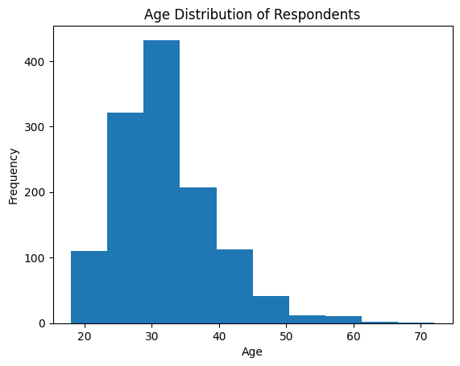
Age Distribution of Respondents

Slide 11
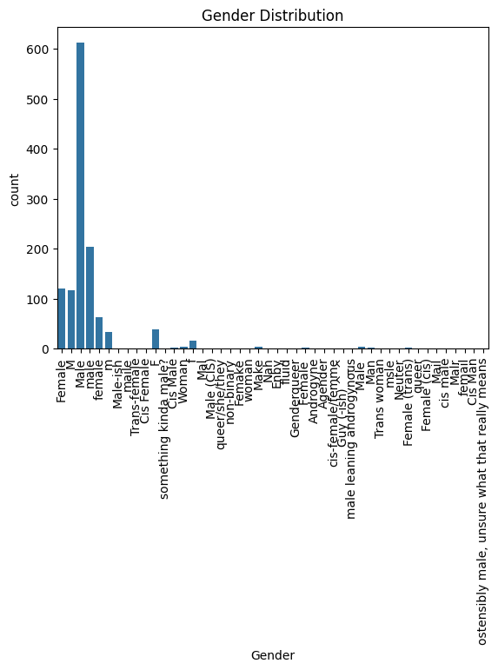
Gender Distribution

Slide 12
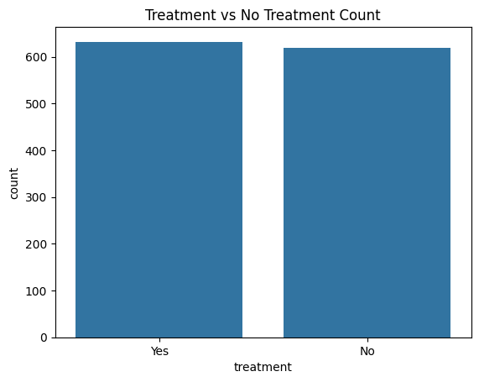
Mental Health Treatment Seeking

Slide 13
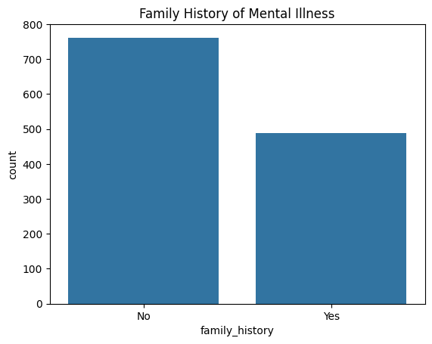
Family History of Mental Illness

Slide 14
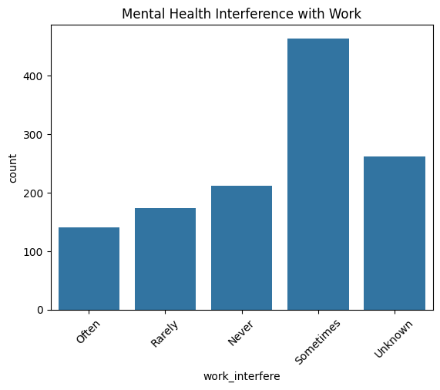
Work Interference due to Mental Health

Slide 15
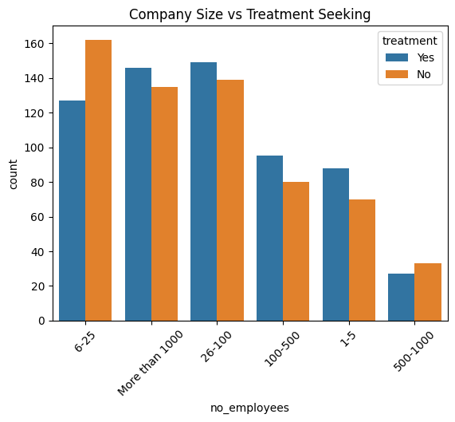
Employer Support: Benefits & Care Options

Slide 16
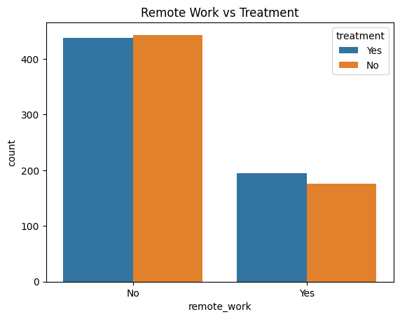
Workplace Openness & Anonymity

Slide 17
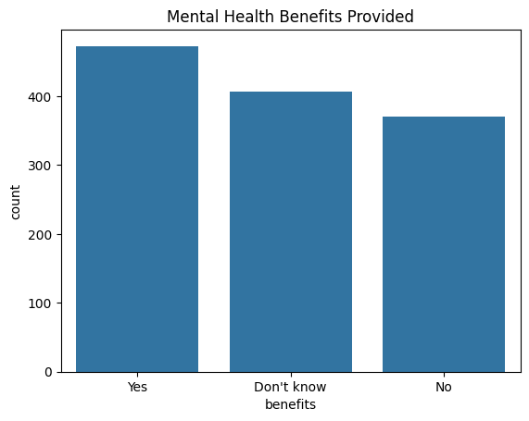
Career Consequences Perception

Slide 18
Key Findings: Mental Health Prevalence
A significant portion of respondents reported experiencing mental health issues
Many individuals have sought treatment, indicating rising awareness
Respondents with a family history of mental illness were more likely to seek help
This highlights the widespread nature of mental health challenges in tech.

Slide 19
Key Findings: Workplace Impact
Many respondents reported that mental health interferes with their work performance
Employees often hesitate to discuss mental health due to fear of negative consequences
Mental health concerns are still treated less openly than physical health issues
Workplace culture plays a major role in employee well-being.

Slide 20
Employer Support & Benefits
A large number of organizations do not provide mental health benefits
Even when benefits exist, employees are often unaware of care options
Wellness programs and mental health discussions are not consistently implemented
This shows a gap between policy availability and employee awareness.

Slide 21
Anonymity & Openness
Employees are more willing to seek help when anonymity is protected
Fear of judgment or career impact discourages open discussions
Supportive managers and coworkers increase mental health disclosure
Psychological safety is crucial for a healthy workplace environment.

Slide 22
Mental vs Physical Health
Many respondents feel that mental health is not treated as seriously as physical health
Physical health issues are more acceptable to discuss at work
Mental health stigma still exists despite growing awareness
Equal treatment of mental and physical health remains a challenge.

Slide 23
Key Insights Summary
Mental health issues are common in the tech industry
Family history and workplace culture influence treatment-seeking
Lack of awareness and stigma reduce effective support
Employer policies alone are insufficient without openness and trust

Slide 24
Conclusion
This exploratory analysis highlights that while awareness of mental health in the tech industry has improved, significant gaps still exist in workplace support, communication, and stigma reduction.
Organizations must move beyond policies and actively foster open conversations, ensure anonymity, and educate employees about available mental health resources.

Slide 25
Future Scope
Future improvements to this project could include:
Analysis of more recent survey data
Predictive modeling to identify high-risk groups
Deeper geographic and role-based analysis
Correlation analysis between company size and mental health support. Integrating this dataset with the 2016 and later mental health surveys could provide longitudinal insights into evolving workplace attitudes

Slide 26
Project Outcome
This project demonstrates the use of Exploratory Data Analysis to derive meaningful insights from real-world survey data.
It showcases:
Data cleaning skills
Analytical thinking
Interpretation of human-centered data
Real-world problem understanding

Slide 27
Project Repository
GitHub Repository:
https://github.com/Anish8800/Mental-Health-EDA
This repository contains:
• Complete Jupyter Notebook with EDA and visualizations
• Cleaned dataset used for analysis
• PowerPoint presentation summarizing insights

